Slide 1


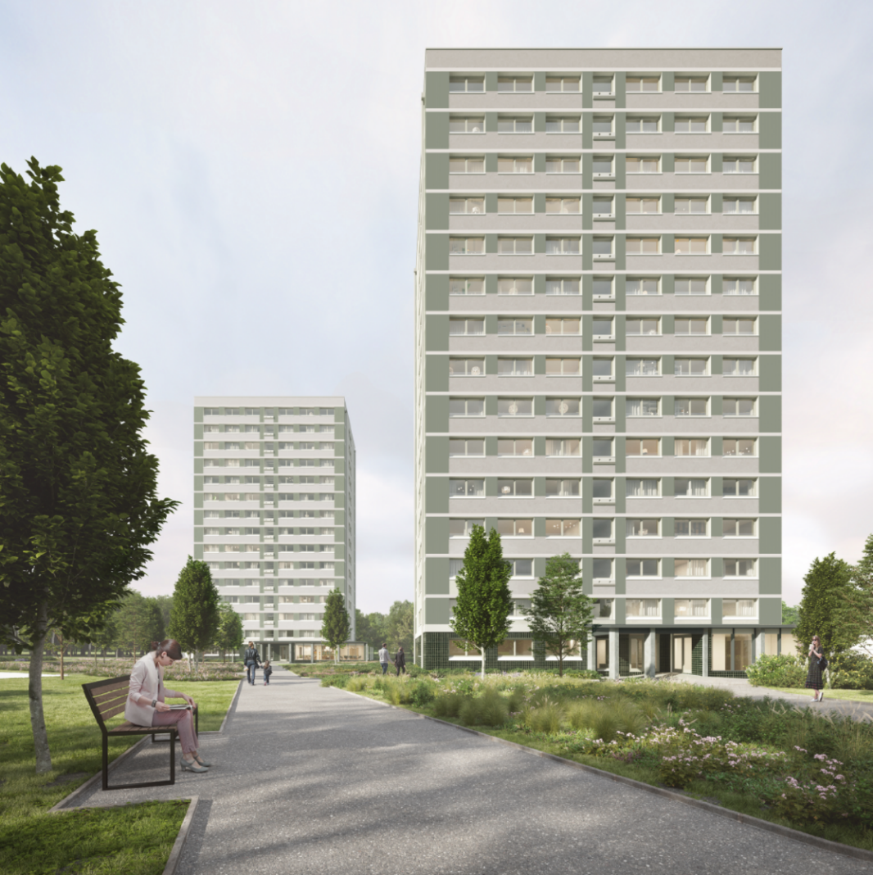
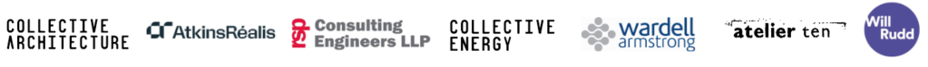

Craigmillar Court
and Peffermill Court
Newsletter 01
1 June 2026
Add Image
Update on refurbishment plans
Dear Resident,
We’re writing to introduce ourselves and to update you on the plans to refurbish and improve Craigmillar Court and Peffermill Court.
We’ve been appointed by the Council to do this work and have significant experience on projects like this.
We’ll be starting work soon and will invite you to a ‘meet the team’ session, so you
can meet the people working on the project, ask questions and raise any concerns you may have.
We understand that there may be some disruption while the work is being done, but the end result will bring lasting benefits to all residents in the blocks and the wider community.
PARTNERS

Slide 2
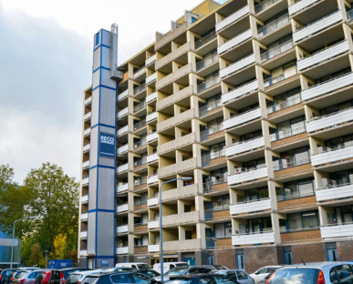
Craigmillar Court
and Peffermill Court
Site set up and temporary car park
Start: June 2026
Complete: July 2026
We’ll begin the first stage of work in June when we start setting up the site. This will involve putting up safety fencing around the buildings to keep everyone safe while work is being done.
During this time, the rear entrances to each block will be closed but you’ll still be able to use the main doors for access.
Our site office will be set up in the car park near Peffermill Court. Unfortunately, this means we’ll need to use some of the existing parking spaces, but we’ll create an additional temporary car park for residents on the grass area next to the school. You can see the plans for this overleaf.
New lifts
Start: August 2026
Complete: September 2027
In August, we’ll begin replacing the existing lifts with brand new ones. These new lifts will stop on every floor, including the top floor, and one of them will also be designed so it can be used by firefighters in an emergency.
You’ll not be able to use either of the existing lifts while we’re replacing them however, we’ll install a temporary one that you can use. It will be fixed to the outside of the blocks and will look similar to the one shown in image 1.1.
Image 1.1
Outdoor improvements
Start Date: August 2026
Completion Date: November 2027
We have plans to improve the outside areas of the blocks including upgrades to walkways, parking areas, road surfaces and the playground. So these works can be done safely, some areas will need to be temporarily closed from time to time.
Temporary flat moves for new kitchens, bathrooms and front doors
Start Date: October 2026
Completion Date: October 2028
So we can upgrade your flat with a new front door, kitchen and bathroom, your household will need to temporarily move out of your flat and into an alternative property for approximately six weeks.
The Council will arrange for you to move into alternative accommodation within the blocks. Both the Council and ourselves will provide you with support throughout this process. We will give you at least eight weeks notice before you need to move. The temporary accommodation cost will be covered by your normal rent payment.
PARTNERS

Slide 3

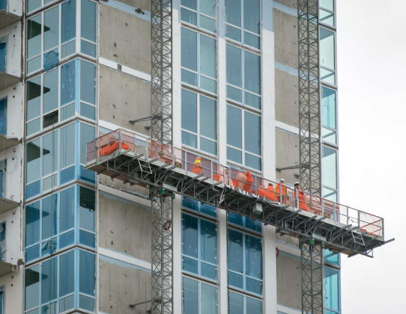
Craigmillar Court
and Peffermill Court
The move will begin on the 14th floor and continue downward, moving one floor at a time.
You’ll be able to stay in your home when we replace your windows.
We know you’ll have questions about this and want to reassure you that we’ll be in touch with more information about what will happen, how you’ll be affected and what you need to do.
Keeping you updated
We understand that you may have some concerns or need further information or assistance. To help with this, we’ve appointed a full time Tenant Liaison Officer (TLO), Kai Ferries. Kai will work alongside the Council’s TLO, Wendy Malkin, and they’ll be in touch soon to introduce themselves.
The TLOs roles are to make sure that the work is carried out as smoothly as possible and that all residents are kept informed, supported and listened to during the process. They’ll act as the main point of contact between all residents and the site team, making sure you have all the information you need and are comfortable during the work.
New roof, windows, insulation and walls Start: January 2027
Complete: September 2027
To make the building warmer, watertight and to reduce damp we’ll install a new insulated roof, new wall insulation and external walls in early 2027.
New triple‑glazed windows will improve warmth, reduce noise and make your home more energy efficient, which will help to lower your energy bills.
We need to install mast climbers to do this work safely. These are platforms fitted on the outside of the building that can move up and down the floors (see image 1.2).
Kai Ferries, Tenant Liaison Officer,
Kier Construction
Our commitment to you
We’ll do everything we can to carry out these works safely and to reduce disruption as much as possible. Thank you for your patience and understanding.
Please don’t hesitate to get in touch in the meantime with the Council HRMI@Edinburgh.gov.uk or Kier kai.ferries@kier.co.uk
Image 1.2
PARTNERS

Slide 4

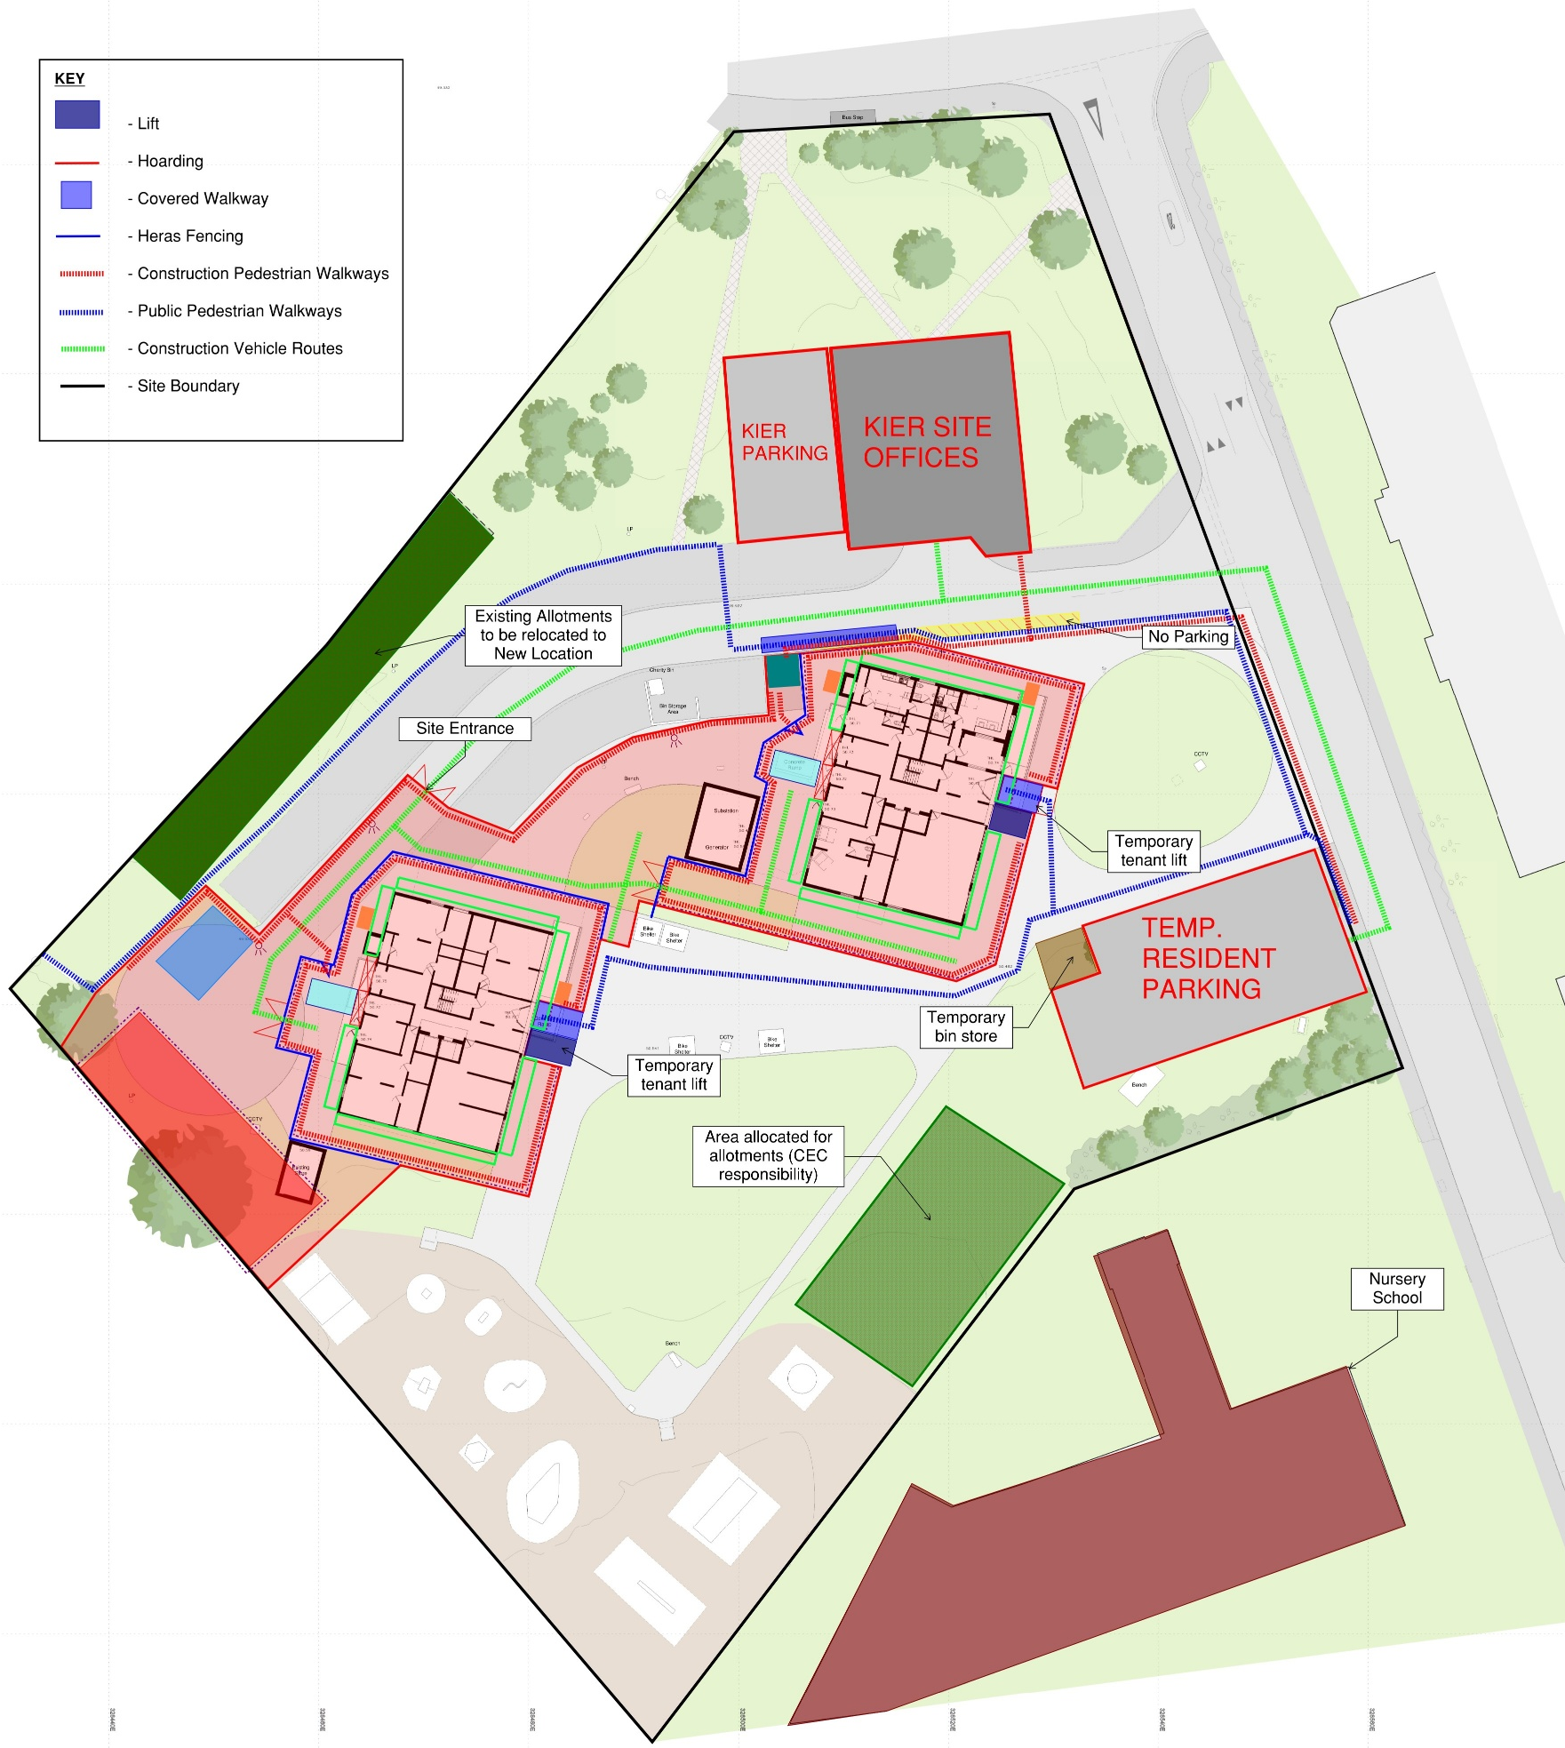
Craigmillar Court
and Peffermill Court
Map of construction site
PARTNERS

