Slide 1

Parental Engagement and Involvement
Delivery Plan
2025 - 2028
Publication | TBC
Review date | TBC
Lead Officers | Donna Murray, Head of Education (Early Years, Parents & Operations) Linda Lees, Head of Wider Achievement & Lifelong Learning

Slide 2

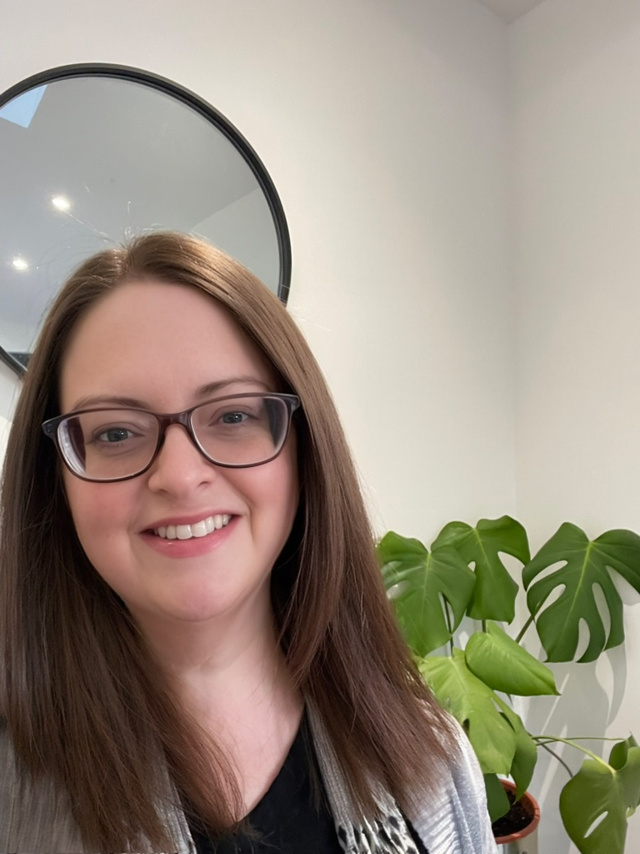

Why this Delivery Plan is Important
Donna Murray
Head of Education (Early years, Parents and Operations)
I believe strong partnerships between Education and Parents/Carers is essential for every child’s success. By fostering open communication, mutual respect, and active collaboration, we create inclusive and supportive relationships that improves outcomes for our children
Louise Collingwood Education Children & Families Parent Representative A clear plan for involving parents and carers in every level of educational decision-making creates the best opportunity for genuine engagement and meaningful discussion about our children’s learning. By prioritising communication, the plan will increase the availability of jargon-free, accessible information to reflect the diversity of Edinburgh’s parent forum.
Alex Ramage
Education, Children & Families Parent Representative
I am really pleased to welcome the plan that the team in the CEC have put together. The team considered that parental discussion was key to getting the delivery plan into a position where the plan has the best chance of delivery.

Slide 3
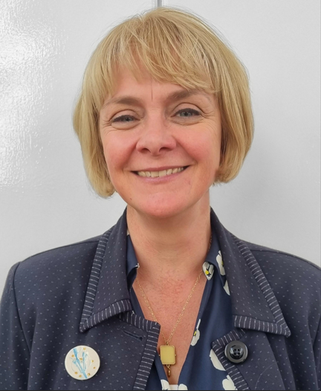
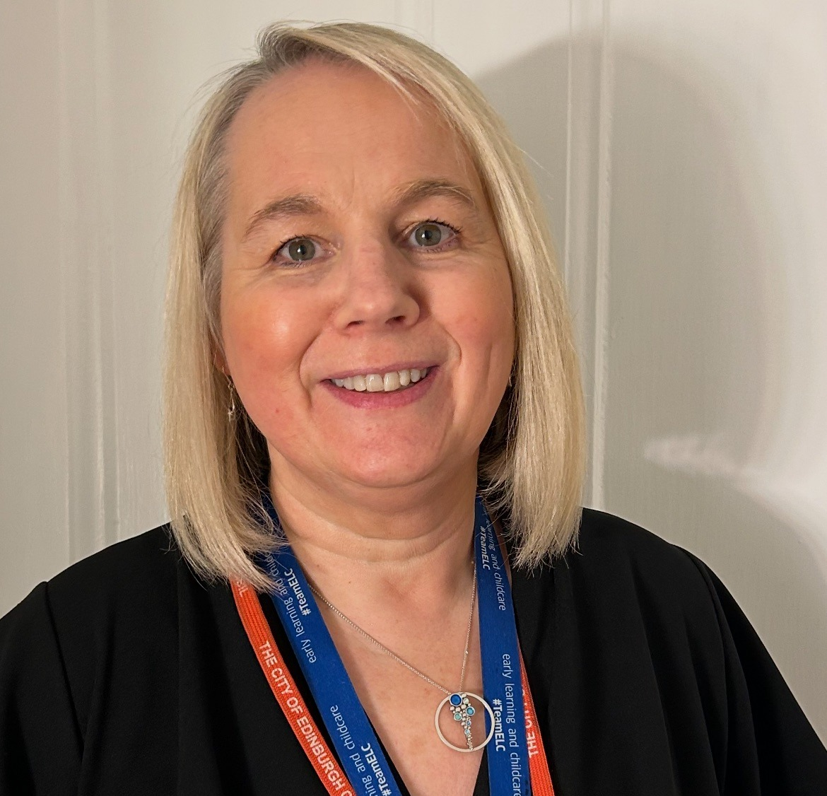
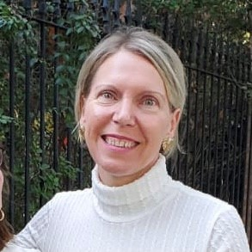
Meet the Team
Paula Greenhill
Early Years & Childcare Manager
This plan demonstrates the commitment to build on the good practice in partnership working. It recognises that parents/carers are a child’s first and often most influential educators. It aims to increase the opportunities for parents to engage in their children’s learning. We know from research this supports improved outcomes for children.’
Caroline Ashbrook
Head Teacher Buckstone Primary, Chair: CEC’s Learning Together Board
The Learning Together Board includes people from CEC Early Years, Primary and Secondary education, families, CEC’s Care-Experienced team, the Wider Achievement and Lifelong Learning team and the Equalities team. The LT Board provides guidance which aims to encourage and support collaborative partnerships between schools, early learning and childcare settings and families to fully support family involvement and engagement.
Pattie Santelices
Wider Achievement and Lifelong Learning Manager with a remit for Supporting Parents & Carers. Our team work hard alongside colleagues to provide high quality parenting programmes and groups, provide information, advice and signposting to best support families as and when they need it. The actions we are taking forward in the delivery plan we hope reflect the work around this

Slide 4

Introduction
Research shows that when parents are engaged in their children’s learning there are improved outcomes for children.
Building strong partnership with parents and with the community that children live in, will continue to be a key focus for the City of Edinburgh Council.

Slide 5
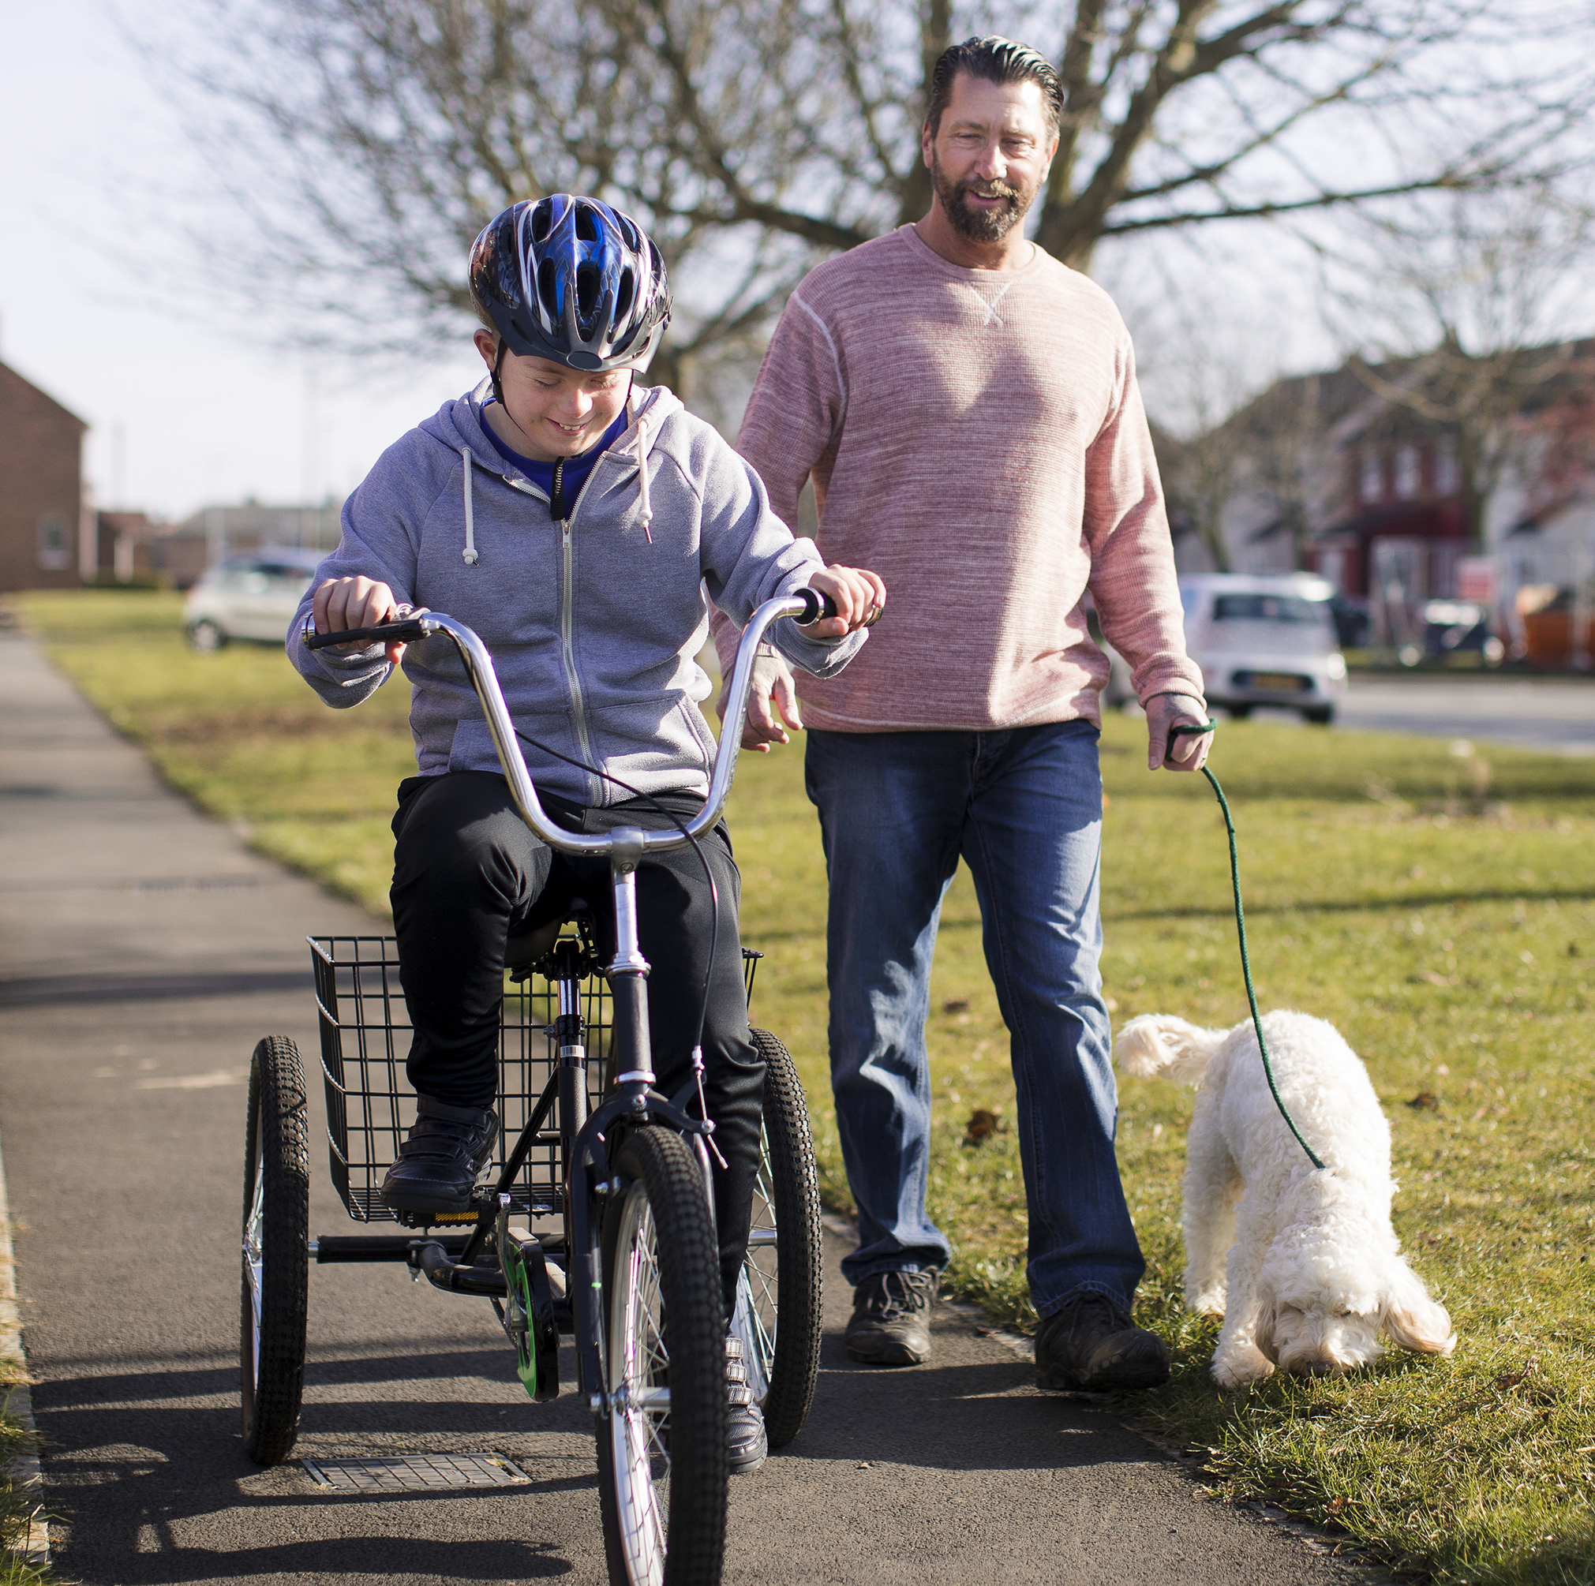
National and local context
The national parenting strategy 2022 highlights the importance of communities ‘helping parents to be the very best they can be to make a positive difference to children and young people’
The City of Edinburgh Council will continue to work with other sectors to build on wider supports for families within their own communities.

Slide 6

Local context
Website - There is a breadth of information for parents on the City of Edinburgh website, however parent feedback is that the website is challenging to navigate. https://www.edinburgh.gov.uk/
In person meetings and networking - In 23-24 there have not been in person learning community parent meetings these will be re established. https://www.edinburgh.gov.uk/parental-engagement/recruitment-selection-training Parent groups – The City of Edinburgh Council
Webpage supporting families’ is available – Support for Families - The City of Edinburgh Council
Parent surveys are currently used to gather feedback by different departments within the council – we will develop a coordinated approach and share feedback.
Evidence based programs – Peep LT- During 2023-24 approximately 15.8% of parents/carers in early learning and childcare in LA settings attended PEEP sessions(925/5850). 82.6% of local authority early years settings in Edinburgh (90/109) had at least one member of staff trained to deliver Peep. 19.3% of staff working directly with children in early years settings were trained to deliver PEEP (235/1215) www.edinburgh.gov.uk/nurseries-childcare/working-partnership-parents
Evidenced based Parenting and Family learning programs – other programs include incredible years, teen triple P, raising children/teens with confidence. Parenting Programmes in Edinburgh
Professional learning opportunities – training is available through the council networks, Education
Scotland, connect and other national bodies. https://connect.scot/
The Edinburgh learn framework has recently been refreshed. This will be shared with communities.
https://www.edinburgh.gov.uk/downloads/file/34257/edinburgh-learns-for-life-outcomes-framework

Slide 7
Improvement Activity | This is how we will do it | By whom / By when | Evidence of impact | How will we know
Improve communication and increase collaboration | Update City of Edinburgh website In person learning community parent Council rep meetings Increased awareness of supporting families’ webpage Carryout a city -wide parental survey | Council officers by January 28 Council officers by June 28 Council officers by August 26 Council officers By August 26 | Parents/carers will report greater satisfaction. Information will be clearer and easier to access. A wider cohort of parent’s voice will be represented. Feedback from parents will help inform improvements and strategic decision making. Parents/carers will report greater satisfaction. Information will be easier to access. Collaboration will increase. Feedback from survey will contribute to delivery plan. | We will monitor central enquiries from parents who are seeking information, enquiries will inform changes to webpages and the number of enquiries will reduce. Feedback gathered will be tracked on education operation team meeting. Solutions will be recorded. Changes to webpage will include improved navigation on webpages. Links will be added between webpages. Main themes gathered in survey will be added to this plan and actioned will be identified.
Increase capacity and skills development opportunities for staff working with parents and carers | Increase delivery of evidenced based Parenting and Family learning programs Increase awareness of wider professional learning opportunities Share the Edinburgh learn – learning together framework | Council officer By Aug 26 Council officers By Jan 26 School leads and Council officers By Jan 26 | Data will evidence increase in delivery and number of families attending. Data will evidence increase in training accessed. Increase in opportunities for parents to be involved in their children’s learning. | Data will be analysed twice a year. Data will be analysed twice a year. Staff will complete a survey annually to ensure learning programs meet the current learning needs of staff. Actions within learning together framework with be complete. This is tracked 3 times in a year.
Develop wider support for families | Build stronger links within communities through the Early Years Hub, Whole Family Wellbeing Hubs and Community Centres | Council officers, 3rd Sector organisation, NHS By June 28 | Data will evidence impact Feedback from parent will report positive outcomes | We currently have baseline data of what is available. Availability will increase.

Slide 8
Update on the action plan November 25
We planned to:
Progress
WEBSITE - We will monitor central enquiries from parents who are seeking information, enquiries will inform changes to webpages and the number of enquiries will reduce.
IN PERSON LEARNING COMMUNITY MEETINGS - Feedback gathered will be tracked on education operation team meeting. Solutions will be recorded.
PARENT SUPPORT -Changes to webpage will include improved navigation on webpages. Links will be added between webpages.
SURVEY - Main themes gathered in survey will be added to this plan and actioned will be identified.
Gather information December 25, adapt webpages, share information.
3 Learning community visits – Tynecastle, Broughton, Boroughmuir , you said we did approach. Drummond Nov 25.
Link have been added to home page, reduce clicks and easier access.
ELC survey live until mid November, parent zone Scotland Oct 25 findings.

Slide 9
Update on action plan – November 25
Evidenced based programs - Data will be analysed twice a year.
Wider professional learning opportunities - Data will be analysed twice a year. Staff will complete a survey annually to ensure learning programs meet the current learning needs of staff.
Actions within learning together framework will be complete. This is tracked 3 times in a year.
Strengthen 3rd sector connection including Whole Family Wellbeing. We currently have baseline data of what is available. Availability will increase.
Gather December and June and identify gaps and next steps.
Annual survey to staff in February.
Ongoing meetings will track this; dates and actions have been agreed. School and early years websites – next steps.
Hubs and referrals in place, joint working continues between 3rd sector and CEC. Track progress.

