Slide 1
Edinburgh Slavery and Colonialism Legacy Review Implementation Group & Supporters Network
Recruitment Pack

Slide 2
Contents
Welcome and Introduction from Irene Mosota, ESCLR Implementation Group Chair
Background Information – Black Lives Matter and the Independent Edinburgh Slavery and Colonialism Legacy Review (2020-2022)
Relevent Documents
Getting Involved - the ESCLR Implementation Group and Supporters Network
Recruitment Information
Getting In Touch

Slide 3
Welcome and Introduction
‘It is my great pleasure as the independent Chair of the Edinburgh Slavery and Colonialism Legacy Review Implementation Group to extend a warm and heartfelt welcome to each one of you.
It is an honour to have you join us in our mission to promote equity, justice, dignity, compassion, and love in our beautiful city.
We believe that diverse voices and perspectives are essential to ensure our Recommendations meet the needs of our entire community. That's why we are actively seeking passionate individuals like you to become members and supporters of this work. Together, we can drive meaningful change and create a more inclusive and equitable city.
I would like to emphasise the crucial role that the business community, government, education, universities and policymakers must play in addressing racial opportunity gaps and dismantling systemic barriers.’

Slide 4
‘It is not enough to simply acknowledge the existence of inequality and racism; we must show brave and courageous leadership and take action to address these issues. By doing so, we can truly realise equity and afford dignity to everyone. I welcome your support.
We owe it to future generations to aspire towards a society that is free from injustice, racism, and inequality. That is our collective responsibility.
I invite you to rise to the challenge and work in the spirit of ‘Harambee’ to build a city that recognises and values all its citizens.
Our collective responsibility must extend beyond words—it requires concrete actions to shape a brighter future for our city. We all have a part to play.
Let us join hands to confront the painful legacy of slavery and colonialism, address its enduring effects, and strive for a society where everyone is treated with dignity, love, compassion and has equal opportunities to thrive.
Thank you for your unwavering support and for being an integral part of this crucial journey. I eagerly look forward to welcoming the new members and supporters to our Group and Network.’
Irene Mosota
Edinburgh Slavery and Colonialism Legacy Review Implementation Group Chair

Slide 5
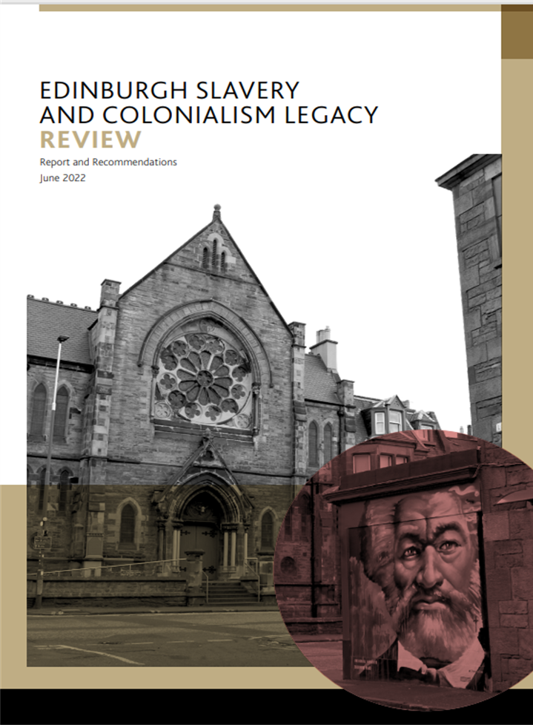
Background Information
Black Lives Matter
Following the murder of George Floyd in May 2020, cities across the world witnessed public demonstrations in support of the Black Lives Matter movement. Several of these took place in Edinburgh where the statues and memorials dedicated to people and events associated with slavery or colonialism became the focal point of community anger.
In July that year, The City of Edinburgh Council’s Policy and Sustainability Committee agreed a set of actions to address historic racial injustice and stem modern day discrimination, including the establishment of an independent review to consider and make recommendations on Edinburgh’s slavery and colonialism legacy in the civic realm. Sir Geoff Palmer was invited to create a Review Group and to lead this work.
Edinburgh Slavery and Colonialism Legacy Review (ESCLR)
The Review Group met over an 18-month period, between December 2020 and June 2022. It decided to follow the UNESCO approach to interpretation as it enabled individual features associated with slavery and colonialism to be related to broader themes of relevance, and then to the issues caused by its legacy today, such as racism and inequality.

Slide 6
Background Information
39 features, categorised under 10 key themes, were identified by the Group as being both representative and illustrative of the degree to which slavery and colonialism were linked to most aspects of city life in the past. These were highlighted in a public consultation which more than 4,000 people and 35 organisations took part in to express their views about how this legacy, and the racism it has resulted in, can be addressed.
The ESCLR Recommendations
Informed by the findings of the public consultation, the Review Group made 10 recommendations as follows:
For the Council to publicly acknowledge the city’s past role in sustaining slavery and colonialism, and to issue an apology to those places and people who suffered.
Statues, monuments, buildings and street names associated with slavery and colonialism in Edinburgh are retained and re-presented in accordance with a new, dedicated interpretation strategy which explains the nature and consequences of that involvement.
City-wide observance of the annual, UNESCO-designated International Day for the Remembrance of the Slave Trade and its Abolition every August 23 is introduced and resourced.

Slide 7
Background Information
4. Teaching and learning materials are developed and delivered to fill the gap in respect of Scotland’s and Edinburgh’s role in slavery and colonialism.
5. Friendship agreements are initiated with cities in countries most impacted by Edinburgh’s historic involvement with slavery and colonialism.
6. Universities and research bodies are encouraged to fund, develop and publish studies into the many under-researched aspects of Edinburgh’s 6 connections with slavery and colonialism, prioritising the objectives of the new interpretation strategy.
7. A significant public artwork is commissioned acknowledging Edinburgh’s links with slavery and colonialism. This initiates the development of a city-wide strategy for public art that fairly represents the diversity of the city and its histories, and capitalises on the creative potential of a multicultural city.
8. A positive programme of cultural commissions is established, empowering and resourcing emerging Black and Minority Ethnic creatives in Edinburgh to participate in and shape existing festivals, arts and heritage programmes.

Slide 8
Background Information
9. The Council endorses the work of the Empire, Slavery and Scotland’s Museums steering group (ESSM) established by the Scottish Government, and commits to exploring how the capital can contribute to the creation of a dedicated space addressing Scotland’s role in this history.
10. An independent legacy stakeholder group is established, supported by the Council, to ensure approved recommendations are actioned, resourced and monitored, and progress is reported annually.
Implementing the ESCLR Report Recommendations
The Report and its 10 Recommendations were endorsed by The City of Edinburgh Council in August 2022 and the first recommendation, a civic apology, was issued by the Lord Provost in October 2022.
The appointment of Irene Mosota as Chair of the new independent ESCLR Implementation Group followed in March 2023, enabling the recruitment process for this Group (as outlined in Recommendation 10) to take place.

Slide 9
Relevent Documents
For further information and relevent background reading, please see:
Policy and Sustainability Committee Report 21.03.23: ESCLR Implementation Group - APM.pdf
Policy and Sustainability Committee Report 30.08.22 introducing the Report and Recommendations of the Edinburgh Slavery and Colonialism Legacy Review: Item 7.11 - Edinburgh Slavery and Colonialism Legacy Review Report and Recommendations.pdf
Policy and Sustainability Committee Response to Motion 23.07.20 – Black Lives Matter
Equality and Diversity Framework: Equality and diversity framework 2021 to 2025 – The City of Edinburgh Council
The City of Edinburgh Council Website Information: Slavery and Colonialism in Edinburgh

Slide 10
Getting Involved - the ESCLR Implementation Group
The Implementation Group will consist of 10 members (including the Chair) of diverse background, age, gender, ethnicity and interests to ensure a mix of views are considered in its work and decision-making. Collectively, the Group will be responsible for overseeing the delivery of the ESCLR recommendations, managing relationships with a range of stakeholders to build momentum for change, and reporting publicly on progress. Individual members will lead on development of plans for the individual Recommendations, based on their specialism or interest.
Members need to be able to commit to a minimum of six meetings over a period of two years initially, with some communication and input required between gatherings. Participation is voluntary and non-renumerated however expenses will be covered. Anyone living or working in Edinburgh with skills or experience in the following areas, is welcome to apply:
Anti-Racist Work
Communications
Culture
Equalities
Fundraising
Heritage Interpretation
Inter-Cultural Working
Learning
Policy Delivery
Project Management
Research

Slide 11
Getting Involved - the ESCLR Supporters Network
The Supporters Network will be a public forum, open to any individual or organisation with an interest in the work of the ESCLR Implementation Group.
Supporters will receive e-bulletins about the work of the Group and will be notified when there is opportunity to feed in to plans or comment on proposals being developed. They will be made aware of any participatory activities being organised in which they might like to take part. Involvement with the Network is voluntary and non-renumerated.
Supporters are not required to formally commit time or to attend meetings or events, and can join the Network at any time – there is no closing date for applications.
Businesses, charitable and learning organisations are very welcome to join the Network and proposals for joint advocacy or joint working to achieve community benefit in alignment with the Recommendations through sponsorship, skills, information or resource sharing are encouraged.

Slide 12
ESCLR Implementation Group Recruitment
Interested in joining the Implementation Group? Please email edinburghlegacyreview@edinburgh.gov.uk with your full name and email address, and a short message outlining four things:
1. Whether you live or work in Edinburgh, or both
2. Why you would like to be considered
3. The skills and/or experience you can offer
4. How you will actively contribute to the Group
The deadline for notes of interest is 5pm on Friday 21 July 2023. Applicants may then be invited to an informal discussion with the Chair (date to be agreed).
Appointments will be made through open application, based on individual merit and needs of the Group. The Chair’s decision about selection is final.

Slide 13
ESCLR Supporters Network Recruitment
To join the Supporters Network please email edinburghlegacyreview@edinburgh.gov.uk with your full name and email address, confirming that your details can be used in accordance with GDPR for communications solely about ESCLR.
No other information is required, however if you would like to specify how you or your organisation could actively support or help to resource the work of the ESCLR Implementation Group, please feel free to include those details.
Supporters are not required to live or work in Edinburgh, and can be based elsewhere in the UK or internationally.

Slide 14
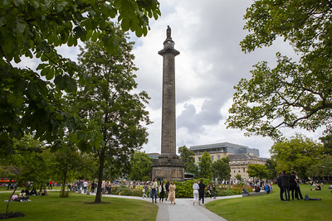
Getting In Touch
If you have any queries, or experience any accessibility issues using this Recruitment Pack, please contact: edinburghlegacyreview@edinburgh.gov.uk
Thank you.

