Slide 1
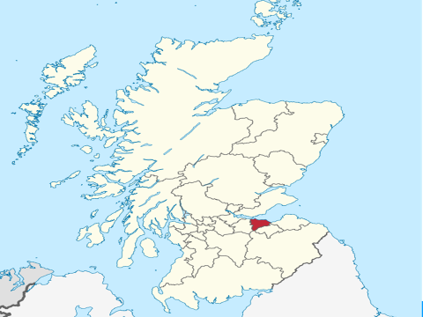
Alcohol availability in Edinburgh
Gemma Crompton, Alcohol Focus Scotland
Dr Niamh Shortt, University of Edinburgh

Slide 2
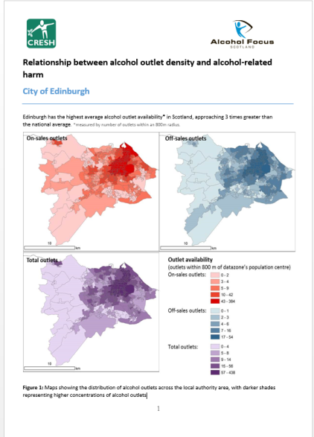
Today’s presentation:
Methods
Key Messages from Edinburgh profile
What it means for Licensing Forums

Slide 3
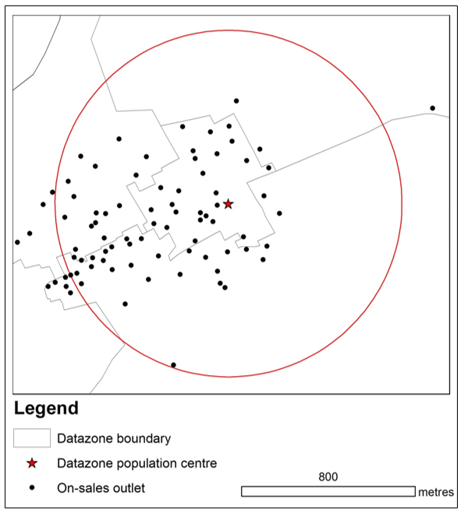

Slide 4
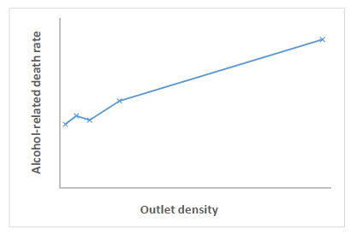
Scotland
On average neighbourhoods have 16 outlets within a 10 minute walk*
(11 on- and 5 off-sales)
Excluding Glasgow & Edinburgh neighbourhoods have 12 outlets within a 10 minute walk*
(8 on- and 4 off-sales)
Highest alcohol availability → high alcohol-related deaths
http://www.alcohol-focus-scotland.org.uk/campaigns/controlling-availability.aspx
http://www.alcohol-focus-scotland.org.uk/media/89725/outlet-density-and-harm-scotland.pdf
*of the population centre

Slide 5
EDINBURGH
Availability
Harm
1755 outlets:
1296 on-sales & 459 off-sales
21 alcohol related deaths per 100,000 adults
On average neighbourhoods have 44 outlets within a 10 minute walk
Alcohol related hospitalisations – slightly lower than Scotland
Relationships between:
Density of on- and off-sales and alcohol-related deaths and hospitalisations

Slide 6
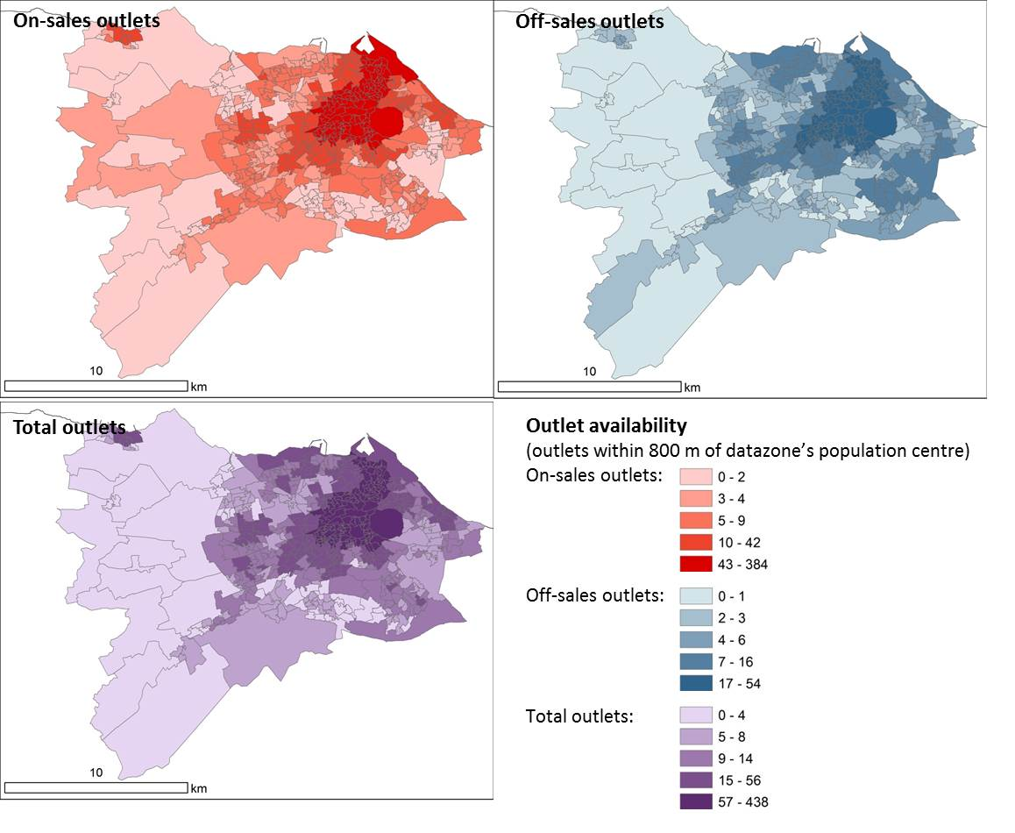
46% of the neighbourhoods have
greater density than national average

Slide 7
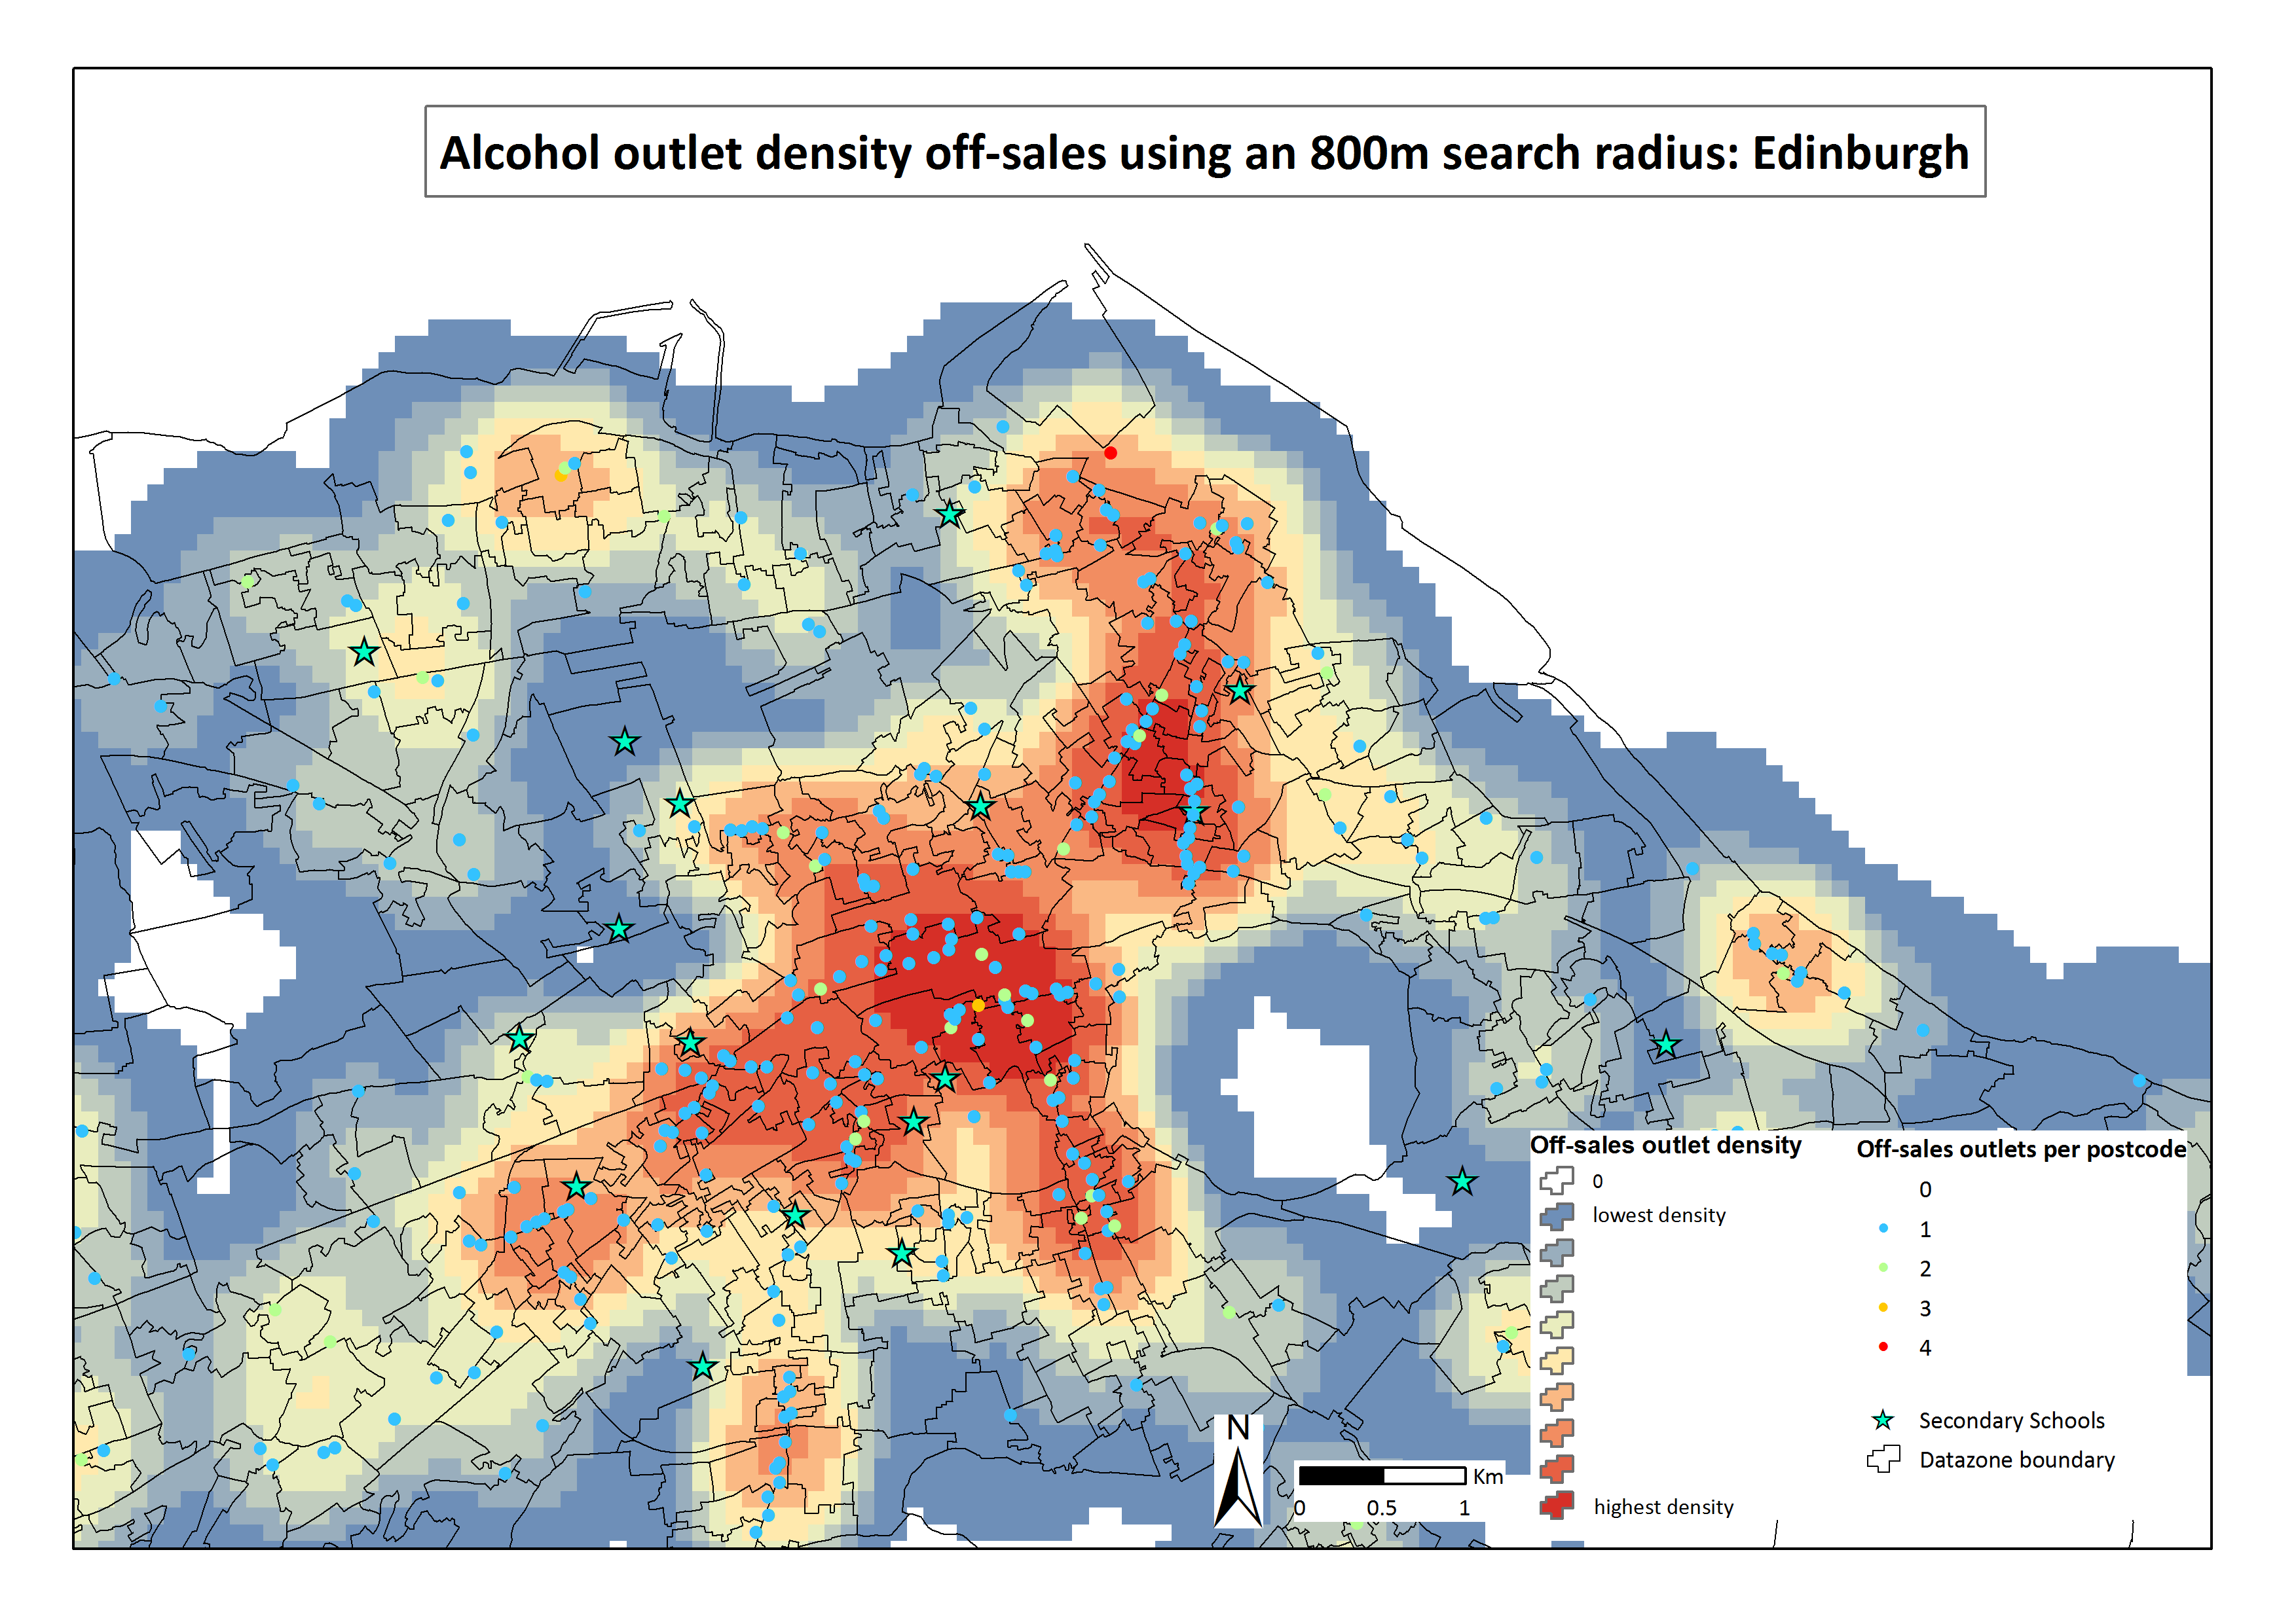

Slide 8
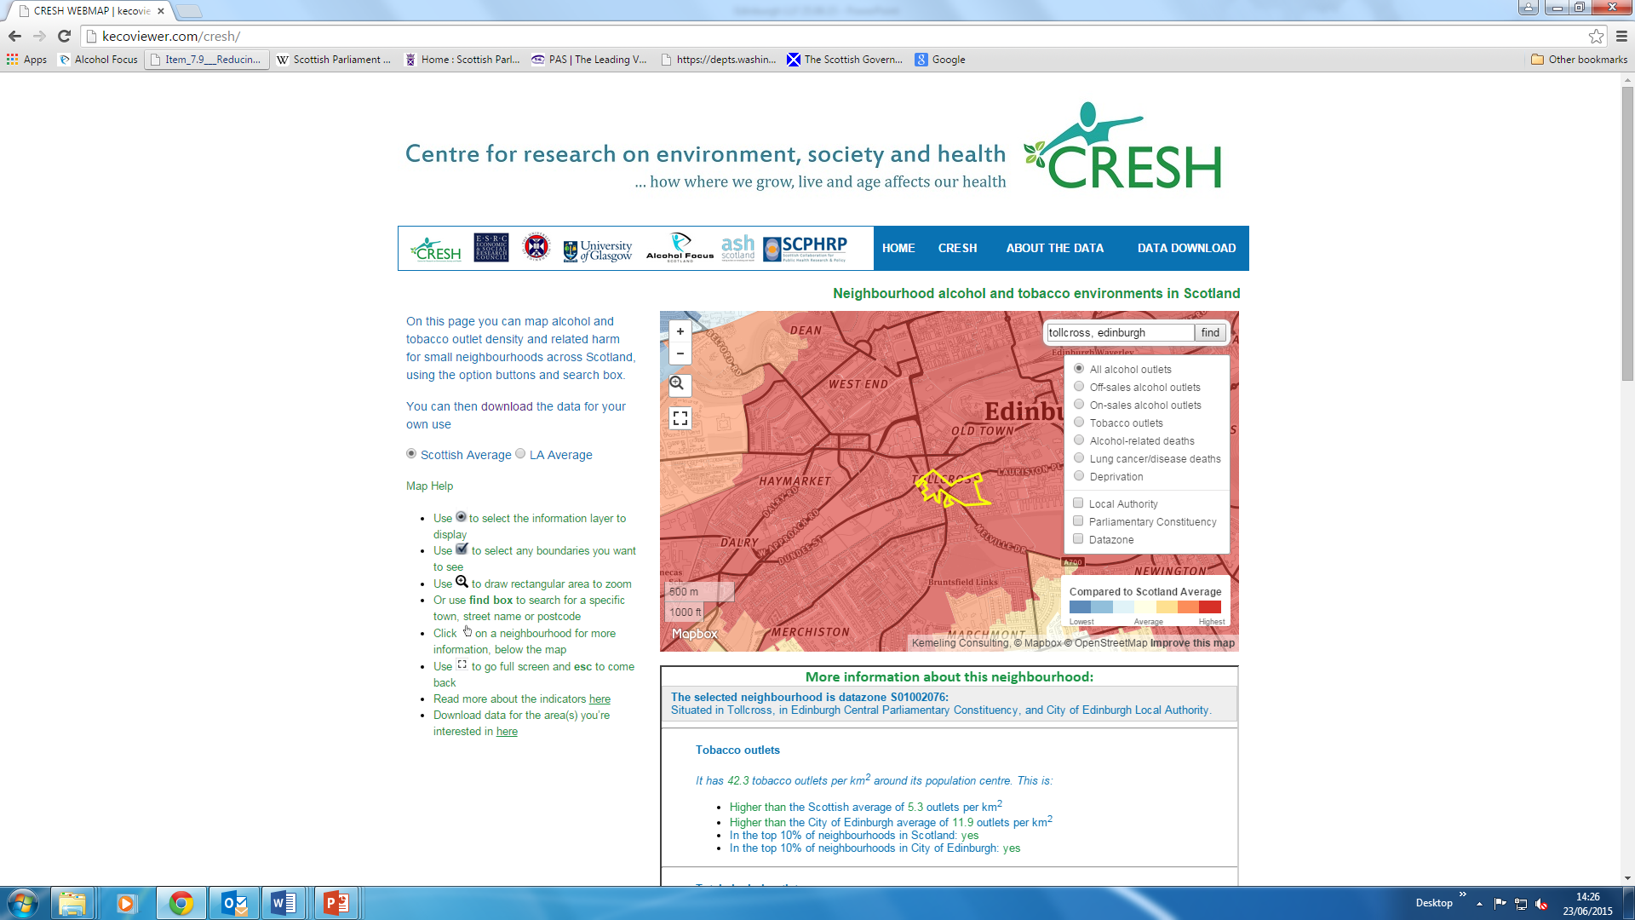

Slide 9
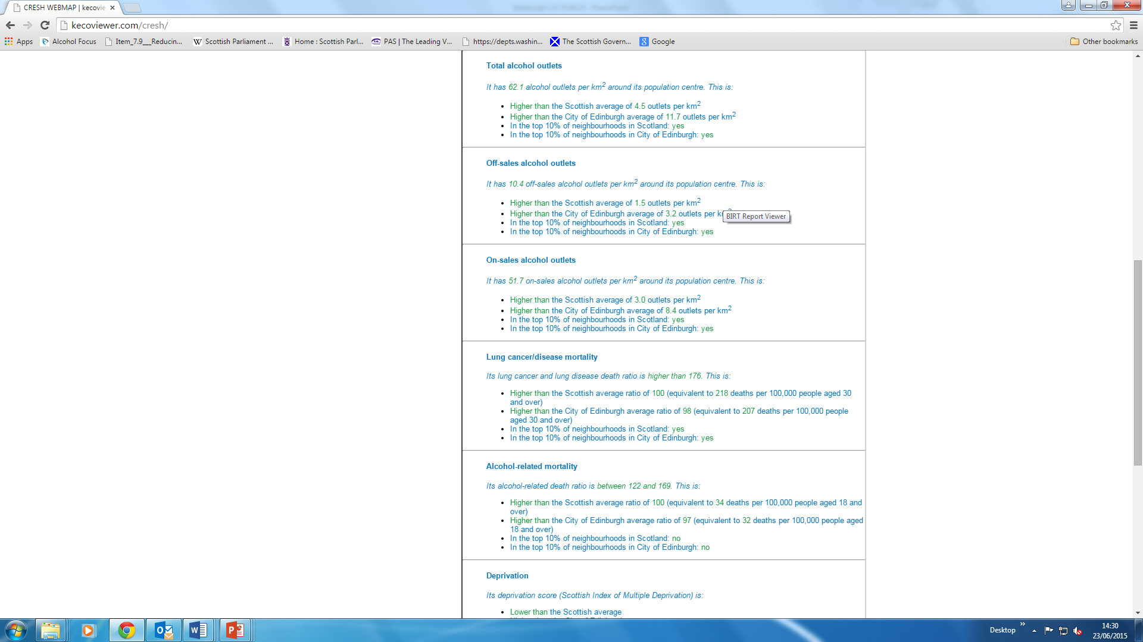

Slide 10
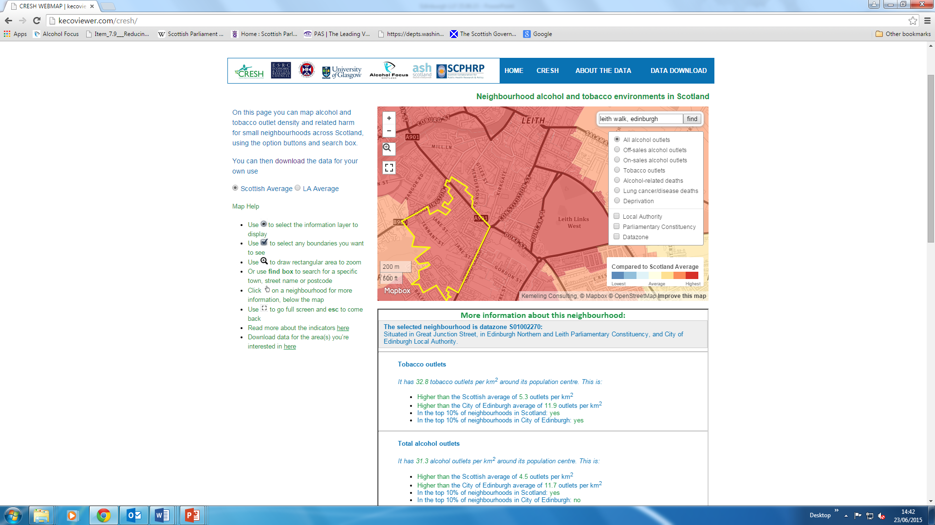

Slide 11
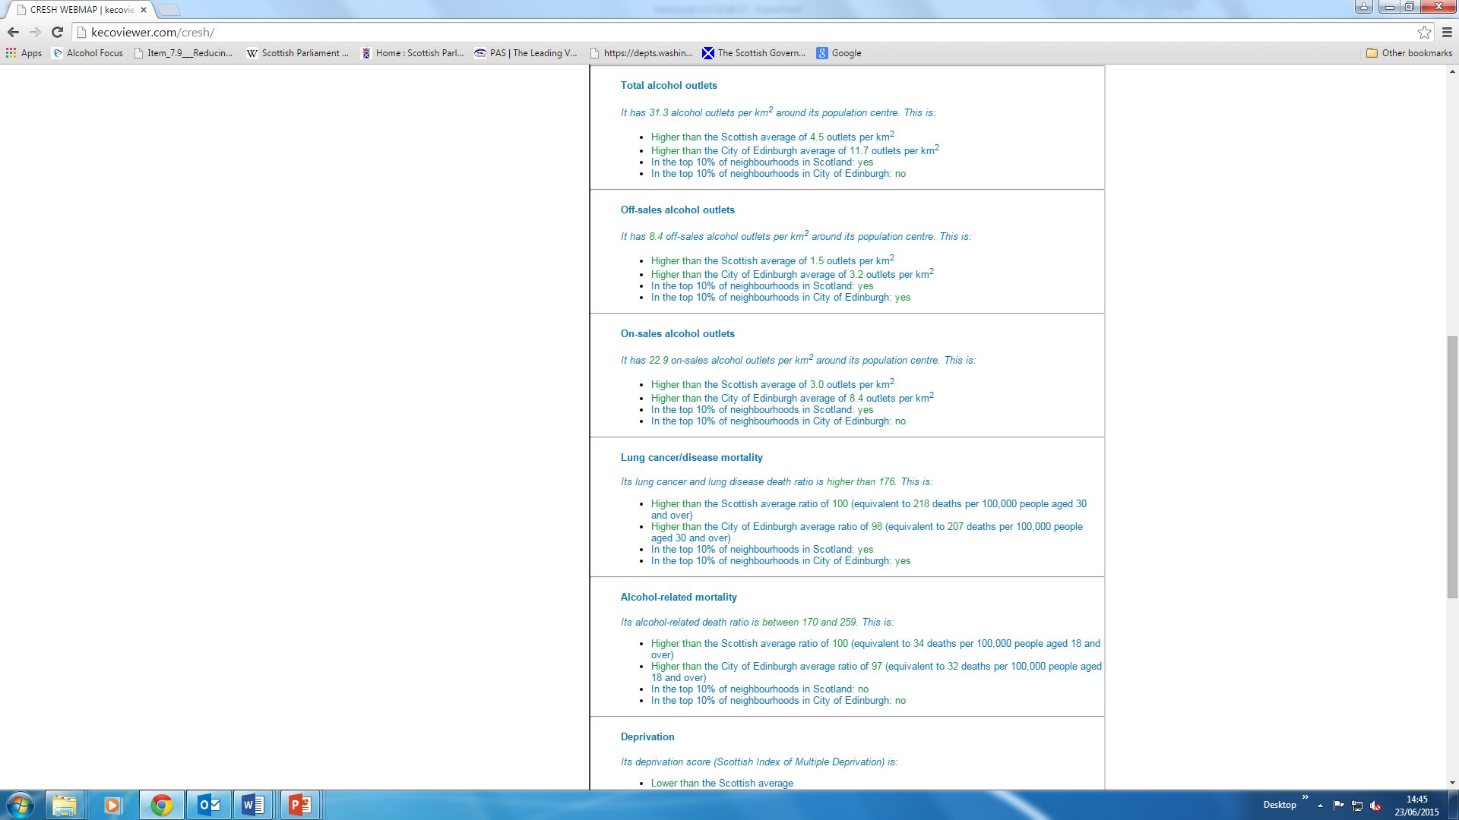

Slide 12
Methods
Key Messages from Edinburgh profile
What it means for Licensing Forums

Slide 13
Licensing: public interest purpose
Regulate
Minimise harm
Alcohol = toxic, intoxicating, addictive
The individual
The population
Public order + public health

Slide 14
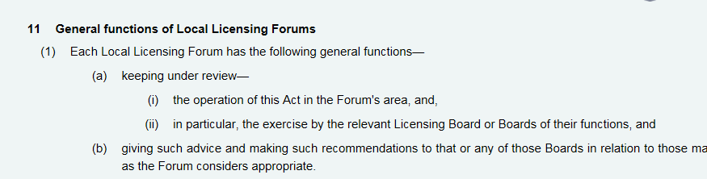
Local Licensing Forum Role
Oversight role
Advice
Statement of licensing policy
The overprovision policy
Decisions in relation to these two policies
(general direction)

Slide 16
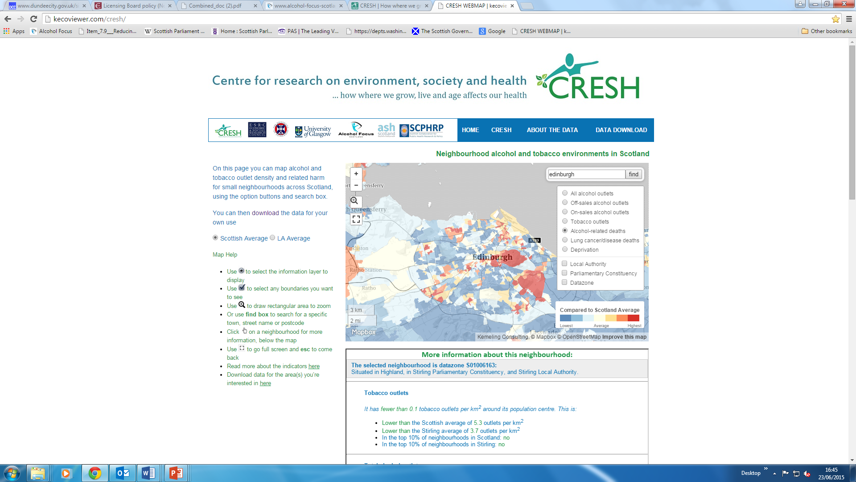

Slide 17
Overprovision Statements
Locality specific:
Aberdeen City: On-sales premises within 2 localities within the city
Glasgow: On and off-sales in 8 intermediate zones
Western Isles: Vertical drinking establishments within Stornoway town centre
Dumfries Galloway: Off-sales premises in central Stranraer
Inverclyde: On and off-sales in Greenock town centre
Premises specific:
Highland: Large (>40m sq) off-sales across whole area
Widespread:
East Lothian: On and off-sales across whole of area
North Ayrshire: On and off-sales across whole of area
West Dunbartonshire: On and off-sales in 17 out of 18 areas
Dundee On and off-sales except the Central Waterfront area

Slide 18
The cost of alcohol
£221.28m Edinburgh - £455 per head
Notes:
Fourthly – think there’s a need to look also at economic cost of alcohol – in Edinburgh costs £455 per head per year in alcohol harm – in the top 4 in Scotland.
On that point of the benefits of a alcohol licence to a premises its worth reflecting on where the costs are….
Red arrow – public spend
The economic benefits of premises tend to go to those businesses/individuals.
Top 4 spend.

Slide 19
Licensing forum: oversight role
Overprovision policy: how is it influencing decisions?
Statement of licensing policy: public health objective
Joint meeting of Board and forum?
Forum’s annual priorities?
Data

Slide 20

Scotland
Frequently Asked Questions

Slide 21
Thank you gemma.crompton@alcohol-focus-scotland http://kecoviewer.com/cresh/
Acknowledgements:
Dr Shortts & colleagues, University of Edinburgh
Deborah Shipton, Linda Bowie, Janine Narciso, Petrina McNaughton, Alcohol Focus Scotland

